Slide 1
Team 5 – Rotor Blade Structures
Week No - 11
Date - 09.12.2025
Supervisor - Dr. Laurence Alhrshy
Presented by – Anudeep Allanki (770625)
Team Members - Bhima B Masare, Anudeep Allanki, Dongsuk Kim, Mithun Shetty

Slide 2
Contents
1. Rotor Blade Structures Team Time line
2. Tasks planned for Project
3. Spar Caps
  3.1 MATLAB Code for Spar Caps Design
      3.1.1 Interpolate Loads for Optimus Syria
      3.1.2 Deflection Calculation
      3.1.3 Results
      4. Pre-Bend in the Rotor Blades
      5. Tower Clearance
Bibliography
Anudeep Allanki

Slide 3
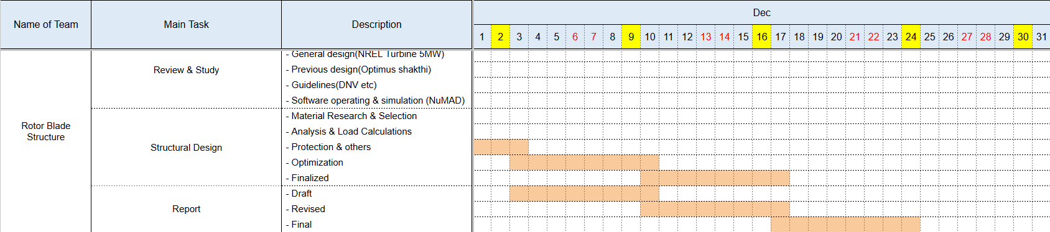
1. Rotor Blade Structures Team Time line -
1.1 Team Time line for Month of December -
Anudeep Allanki

Slide 4
2. Tasks planned for Project –
Material Selection
Spar Cap & Shear Web Thickness
Develop Blade Model in NuMAD
Analysis with Precomp
Iterate and refine the design
Dongsuk Kim

Slide 5
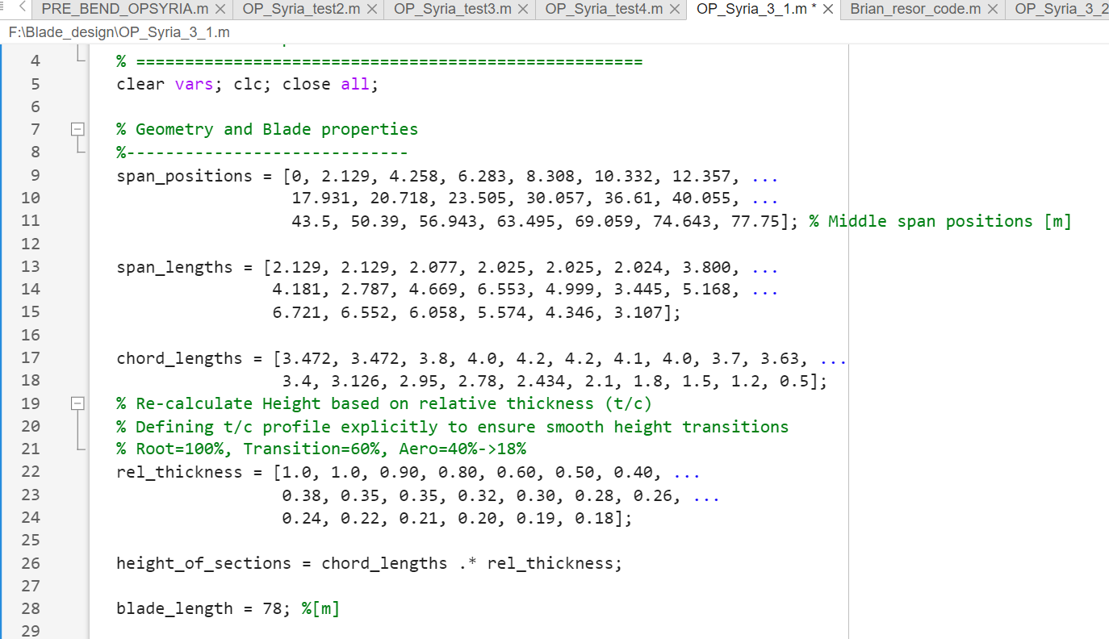
3. Spar Caps –
3.1 MATLAB Code for Spar Caps Design -
Anudeep Allanki

Slide 6
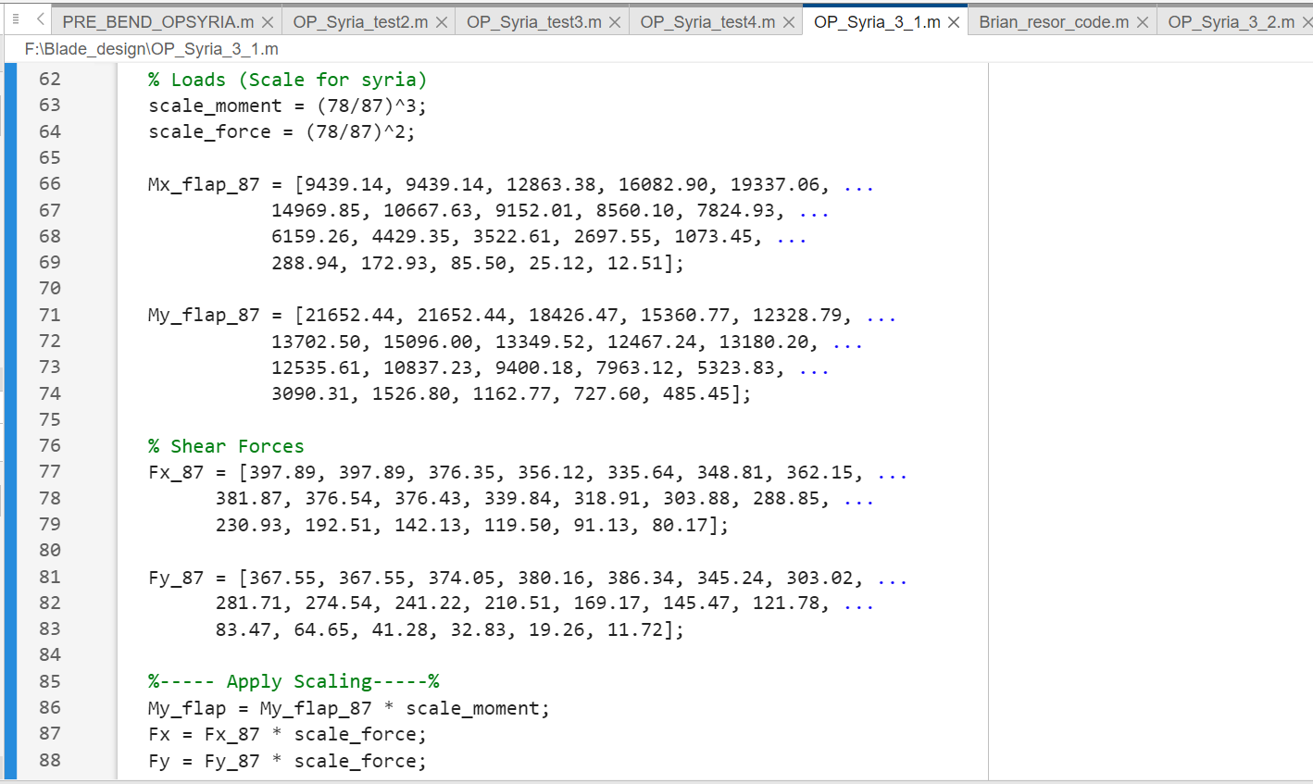
3. Spar Caps –
3.1.1 Interpolate Loads for Optimus Syria (Using Shakthi data) (20 Nodes) –
Anudeep Allanki

Slide 7
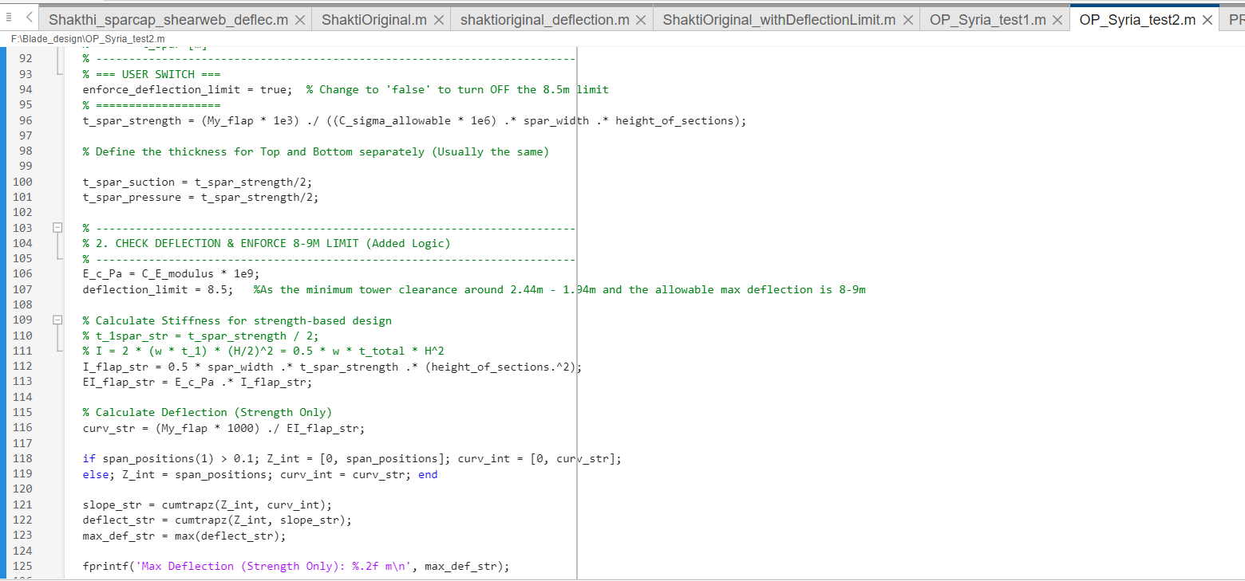
3. Spar Caps –
3.1.2 Deflection Calculation – (Using Switch Case to enforce Deflection Limit of 8 – 9 m) –
Anudeep Allanki

Slide 8
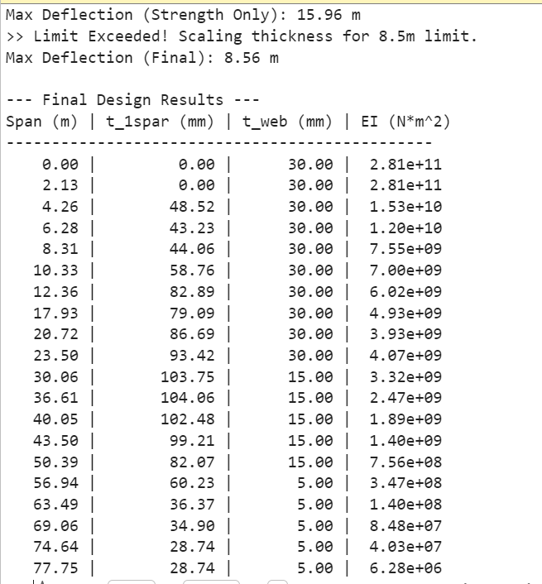
3. Spar Caps –
3.1.3 Results –
The result which we got after executing the MATLAB code
The Max deflection we got is 15.96 m
We have limited the maximum deflection to 8.5 m as per our design requirements by altering the thickness of these spar caps and webs
Anudeep Allanki

Slide 9
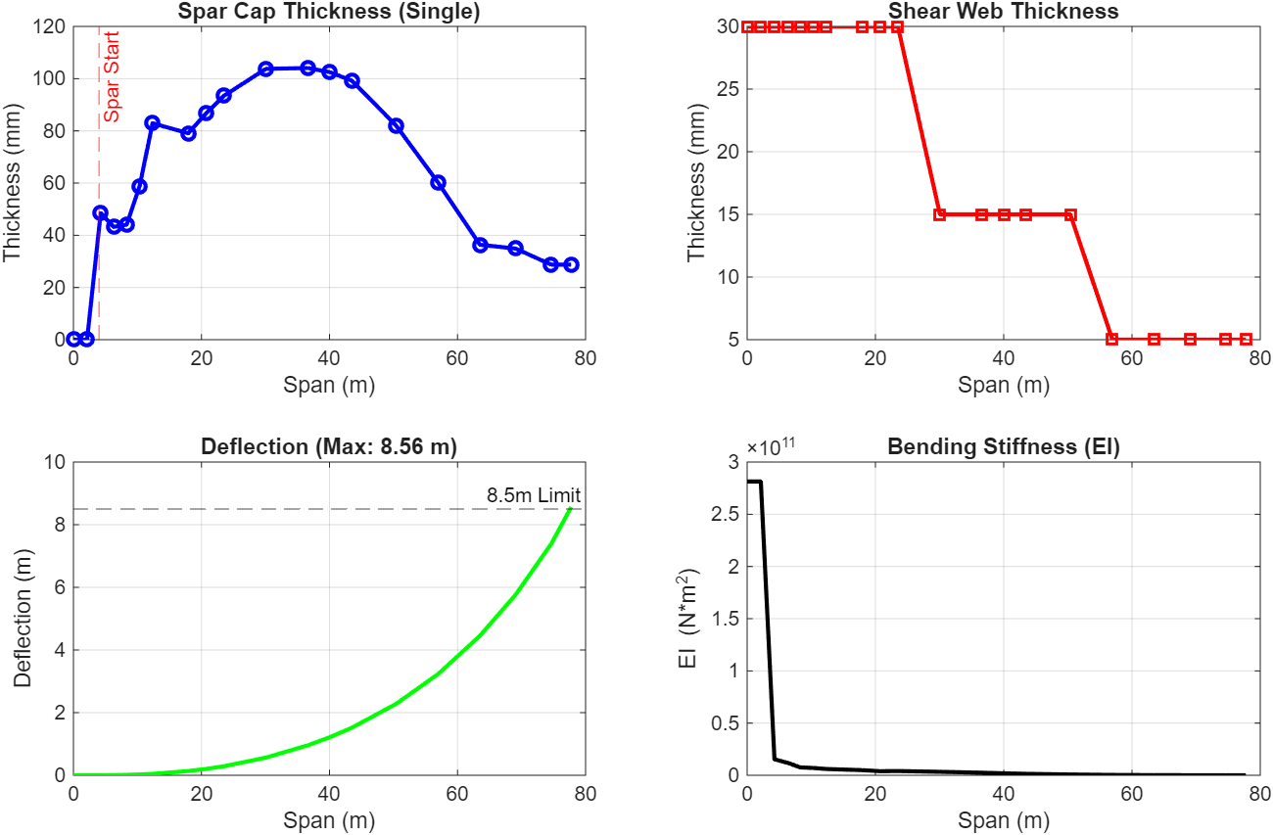
3. Spar Cap –
3.1.3 Results –
a. Plots from MATLAB for Bending Analysis with Deflection Limit (8.5 m) –
Anudeep Allanki

Slide 10
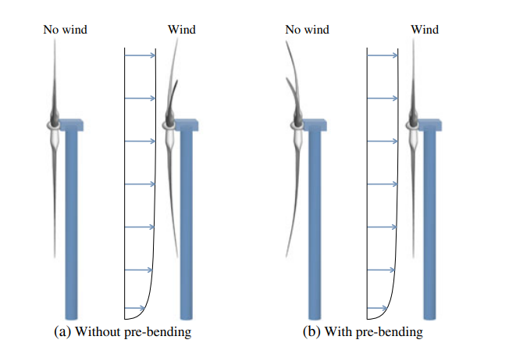
4. Pre-Bend in Rotor Blades
4.1 Pre-Bend –
Pre-bend is the intentional curvature built into a wind turbine blade to keep the blade tip away from the tower, ensuring it straightens under load and avoids tower strikes.
It is essential for long flexible blades as it provides extra tower clearance, prevents tower strike, more cost-efficient spar cap design without compromising safety under extreme wind loads.
Source – A computational procedure for pre-bending of wind turbine blades. University of California
Anudeep Allanki

Slide 11
4. Pre-Bend in Rotor Blades –
4.1 Pre-Bend –
a. NREL 5 MW –
  For NREL 5MW turbine (61.5m), the blade is defined as perfectly straight along the pitch axis with NO Pre – Bending as it is a theoretical Reference turbine, but with a cone angle of 2.5°.
  For the Optimus Shakti WEC 2024 (87 m), the blade is designed with a pre-bend of 3.5 m and a cone angle of 2.5°.
b. Optimus Syria WEC 2025 (78m) –
  The provided Cone angle from the Management Team is 4.0 °.
  Consider safety factor of (1.35x) as per IEC standards defining the pre-bend value
  Cone angle Contribution must be calculated as well for defining the Pre-bend value.
Anudeep Allanki

Slide 12
4. Pre-Bend in Rotor Blades –
4.1 Pre-Bend – (formulas)
  Formula for calculating Pre – Bend, Cone Benefit, Static Space –
    Pre-Bend = Static Space – (Overhang + Cone Benefit)
    Cone Benefit = Blade Length × sin(θ)
  (Note – For Optimus Syria (78 m Blade) Cone angle is 4 °. So, Cone Benefit = 5.44m)
  Static Space = 1.35 × Deflection = 11.47 m ( for Optimus Syria)
  Consider, the overhang value as 2.5 m ( Hub team need to confirm)
  So, we get the final Pre-Bend value as 3.5 m
Anudeep Allanki

Slide 13
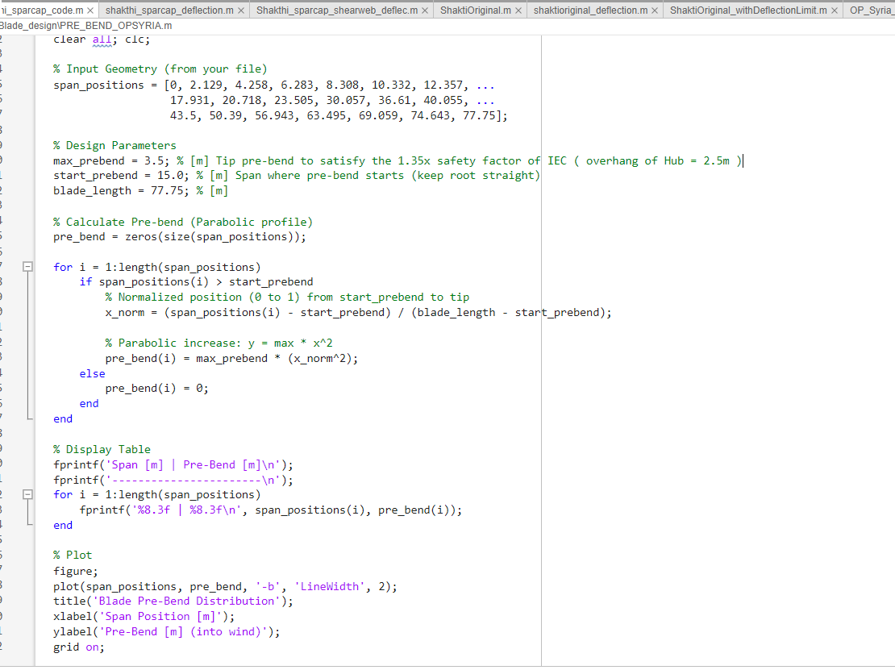
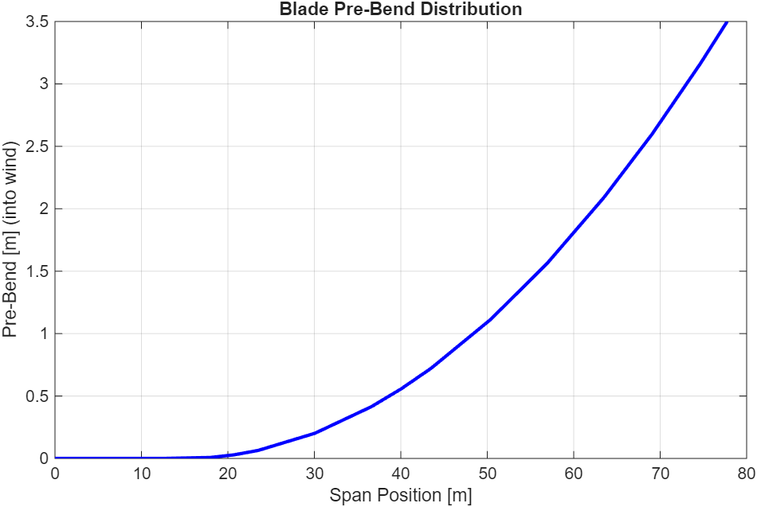
4. Pre-Bend in Rotor Blades –
4.1 Pre-Bend – (contd.)
For 0 m– 15 m : No Pre- bend (Straight root for manufacturing/transport).
From 15 m – 78 m : Parabolic curve increasing to the maximum value at the tip
Anudeep Allanki

Slide 14
5. Tower Clearance –
5.1 Tower Clearance – (formulas)
For 0 m– 15 m: No Pre-bend (Straight root for manufacturing/transport)
For 15 m – 78 m: Parabolic curve increasing to the maximum value at the tip
  Tower Clearance = Static Space – Deflection
  = 11.47 m – 8.5 m = 2.97 m
  Tower clearance as per Optimus Shakti reports it is around ~ 4.68m for a deflection of 9.5 m (reference from Shakti Data)
  For Optimus Syria the tower clearance would be around ~ 2.97 m
Anudeep Allanki

Slide 15
Bibliography
Definition of a 5 MW/61.5m Wind Turbine Blade Reference Model by Brian R. Resor, Sandia National Laboratories, California, USA
Definition of a 5 MW Reference Wind Turbine for Offshore System Development, J. Jonkman, S. Butterfield, W. Musial, and G. Scott, National Renewable Energy Laboratory, USA
Reports from Optimus Shakthi 2024
Lecture Scripts from Prof. Dr. Francesco Previtali
Lecture Scripts from Prof. Dr. Laurence Alhrshy
Impact of Process Technology on Properties of Large-Scale Wind Turbine Blade Composite Spar Cap by Yuanrong Sun, Congli Hu, Jianbo Li
Multi-disciplinary constraint optimization of wind turbines by Carlo Luigi Bottasso, Filippo Campagnolo, Alessandro Croce
A concept study of a carbon spar cap design for a 80m wind turbine blade by Malo Rosemeier, M Bätge
Design & Analysis of Equipment for Load Introduction during Full Scale Blade Test by J. Andersen, M. Escudero, L. Larsen, J. Thuesen, A. Vissamsetty
Anudeep Allanki

